Slide 1
GRADE 7 ACCELERATED · UNIT 6 · THREAD B · DAY 1
Angle Pairs: Supplementary, Complementary, Vertical, Adjacent
MA.8.GR.1.4
I can name an angle pair and use it to find a missing angle, with an equation when the angles are expressions.
Grade 7 Accelerated · Unit 6 · Thread B · Day 1 — Angle Pairs: Supplementary, Complementary, Vertical, Adjacent
1

Slide 2


Warm-Up
1. A 6-ft man casts a 4-ft shadow; a tree, 18 ft. The tree's height?
2. How far apart are
and
?
3. Ana types 210 words in 5 minutes. Words per minute?
4. Two angles make a straight angle. One is 130°. The other?
Grade 7 Accelerated · Unit 6 · Thread B · Day 1 — Angle Pairs: Supplementary, Complementary, Vertical, Adjacent
2

Slide 3
Warm-Up
1. A 6-ft man casts a 4-ft shadow; a tree, 18 ft. The tree's height?
27 ft
2. How far apart are
and
?
9 units
3. Ana types 210 words in 5 minutes. Words per minute?
42
4. Two angles make a straight angle. One is 130°. The other?
50°
Grade 7 Accelerated · Unit 6 · Thread B · Day 1 — Angle Pairs: Supplementary, Complementary, Vertical, Adjacent
3

Slide 4
Vocabulary
adjacent angles
two angles with the same vertex and a shared side, that do not overlap
vertical angles
the angles across from each other where two lines cross; they are equal
complementary angles
two angles that add to 90°
supplementary angles
two angles that add to 180°; a linear pair (adjacent, on a straight line) is supplementary
Grade 7 Accelerated · Unit 6 · Thread B · Day 1 — Angle Pairs: Supplementary, Complementary, Vertical, Adjacent
4

Slide 5
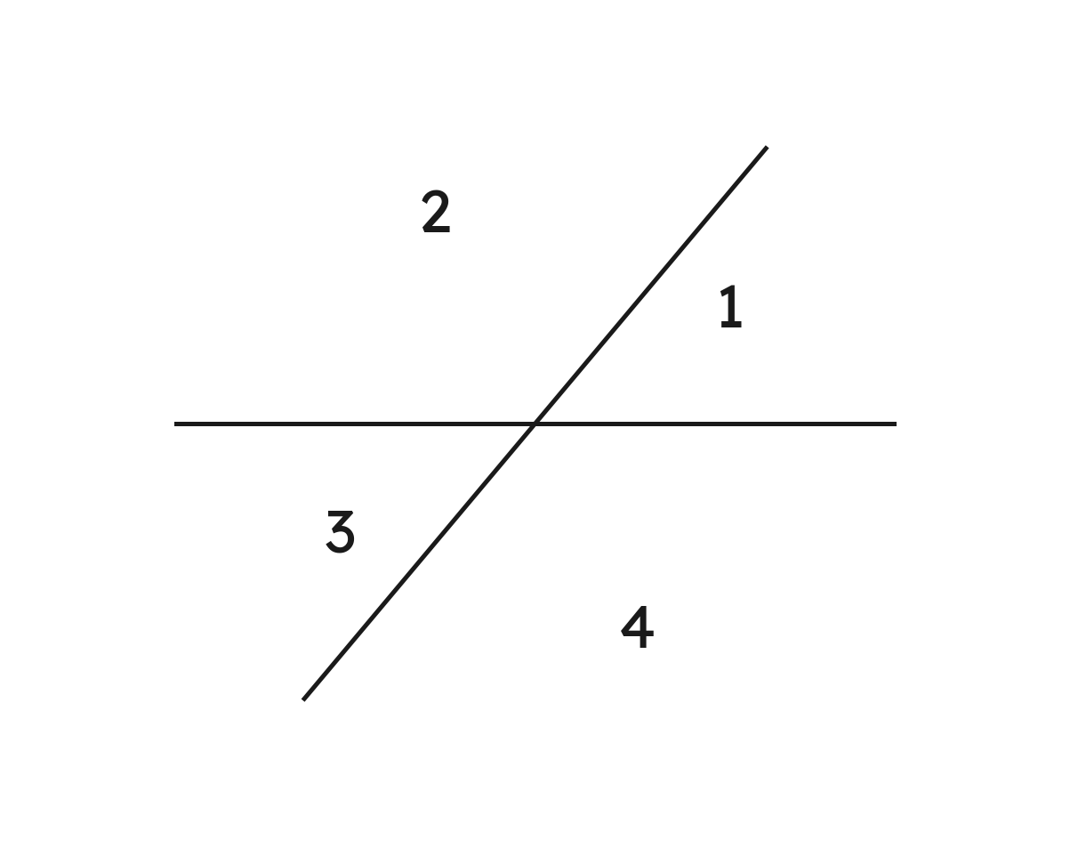

Notes
I. Adjacent and vertical
Adjacent: one vertex, a shared side, no overlap — angles 1 and 2.
Vertical: across, and equal —
(m for measure).
Grade 7 Accelerated · Unit 6 · Thread B · Day 1 — Angle Pairs: Supplementary, Complementary, Vertical, Adjacent
5

Slide 6
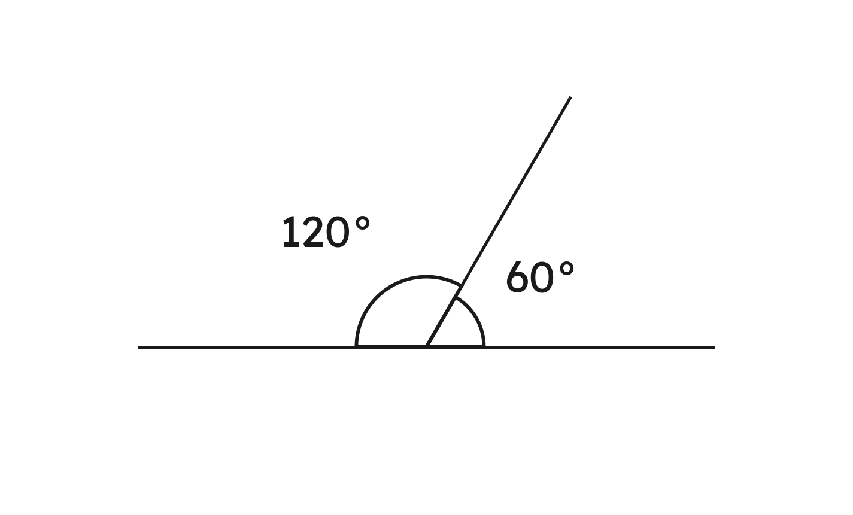
Notes
II. Complementary and supplementary
Complementary: add to 90°. Supplementary: add to 180°.
A linear pair is supplementary: 60° + 120° = 180°.
Grade 7 Accelerated · Unit 6 · Thread B · Day 1 — Angle Pairs: Supplementary, Complementary, Vertical, Adjacent
6

Slide 7
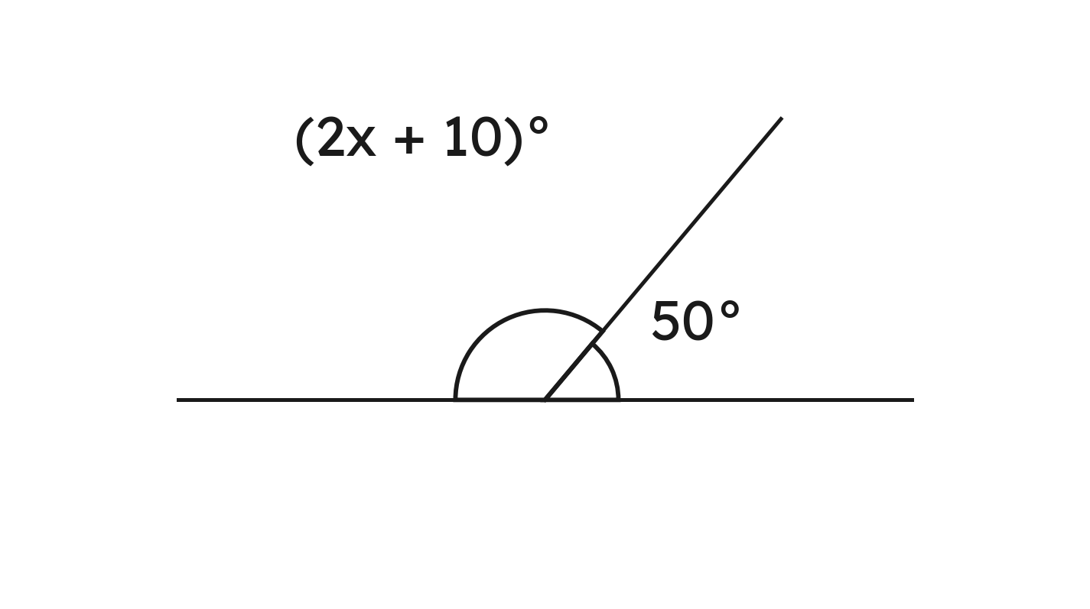



Notes
III. Name the pair, write the equation, put x back
,
,
the angle:
Grade 7 Accelerated · Unit 6 · Thread B · Day 1 — Angle Pairs: Supplementary, Complementary, Vertical, Adjacent
7

Slide 8


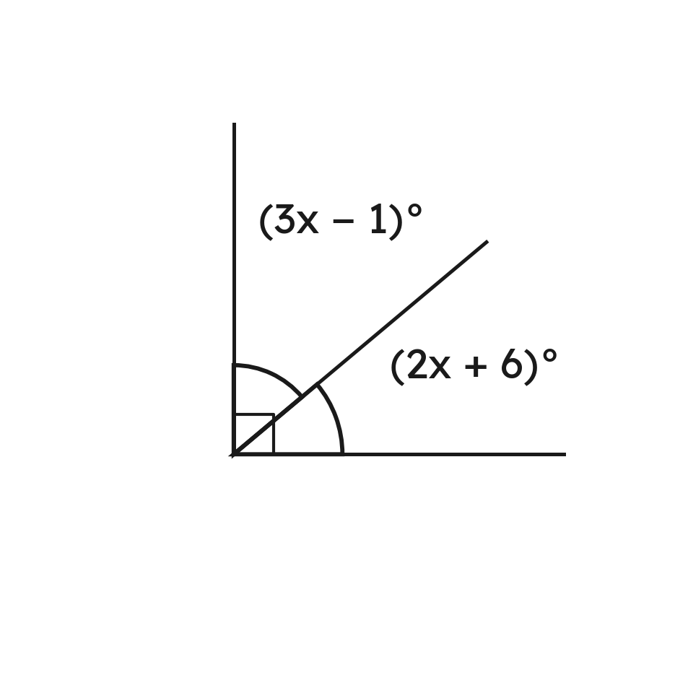
Example 1
A ray splits a right angle into
and
.
Find x and both angles.
Grade 7 Accelerated · Unit 6 · Thread B · Day 1 — Angle Pairs: Supplementary, Complementary, Vertical, Adjacent
8

Slide 9

Example 1
Answer: x = 17; the angles are 50° and 40°
Grade 7 Accelerated · Unit 6 · Thread B · Day 1 — Angle Pairs: Supplementary, Complementary, Vertical, Adjacent
9

Slide 10


Your Turn
and
are complementary.
Find x and both angles.
Grade 7 Accelerated · Unit 6 · Thread B · Day 1 — Angle Pairs: Supplementary, Complementary, Vertical, Adjacent
10

Slide 11







Your Turn
and
are complementary.
Find x and both angles.
,
,
,
Answer: x = 16; 64° and 26°
Grade 7 Accelerated · Unit 6 · Thread B · Day 1 — Angle Pairs: Supplementary, Complementary, Vertical, Adjacent
11

Slide 12


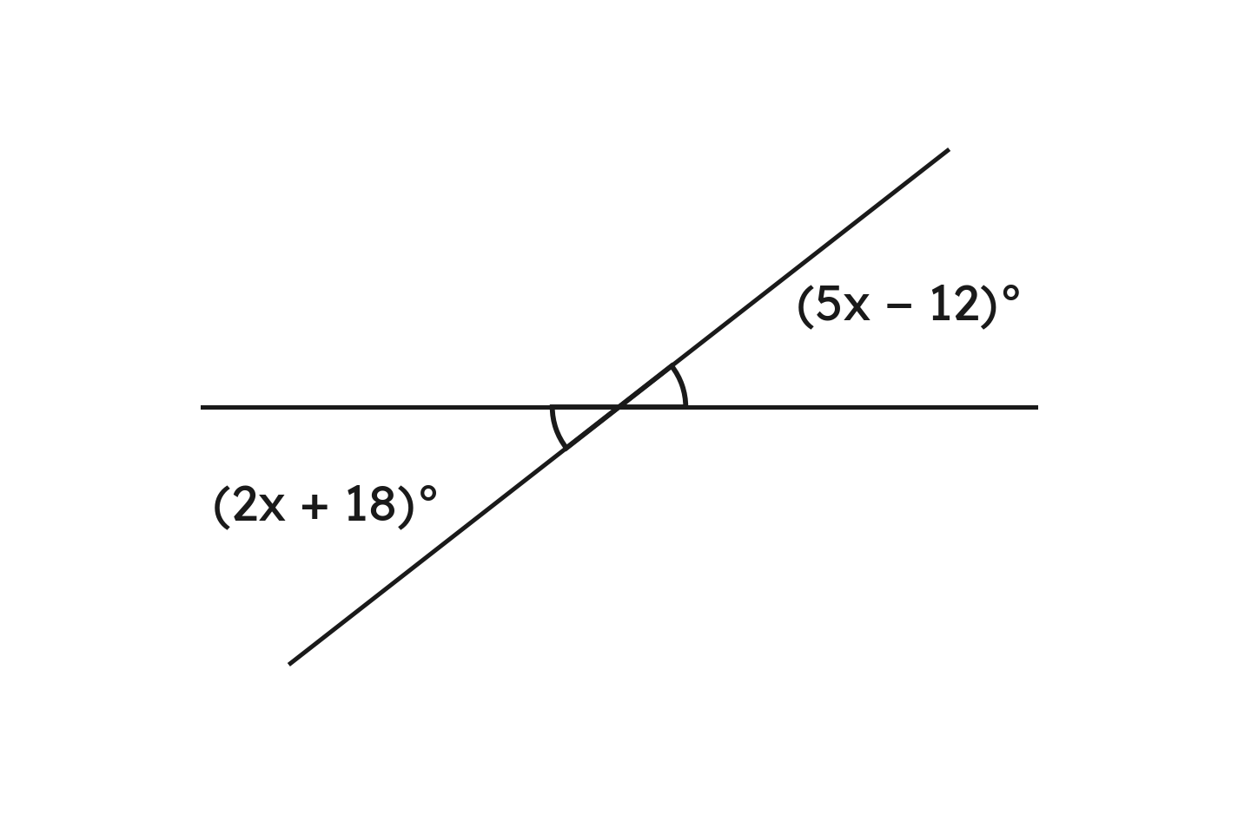
Example 2
Two lines cross. Vertical angles measure
and
.
Find the measure of each angle.
Grade 7 Accelerated · Unit 6 · Thread B · Day 1 — Angle Pairs: Supplementary, Complementary, Vertical, Adjacent
12

Slide 13




Example 2
Answer: Each angle is 38°.
Grade 7 Accelerated · Unit 6 · Thread B · Day 1 — Angle Pairs: Supplementary, Complementary, Vertical, Adjacent
13

Slide 14


Your Turn
Vertical angles measure
and
.
Find the measure of each angle.
Grade 7 Accelerated · Unit 6 · Thread B · Day 1 — Angle Pairs: Supplementary, Complementary, Vertical, Adjacent
14

Slide 15






Your Turn
Vertical angles measure
and
.
Find the measure of each angle.
equal: 4x + 3 = x + 39
take x off both sides:
,
Answer: Each angle is 51°.
Grade 7 Accelerated · Unit 6 · Thread B · Day 1 — Angle Pairs: Supplementary, Complementary, Vertical, Adjacent
15

Slide 16
Whiteboards · Question 1 of 9
What is the complement of 34°?
Answer it.
Grade 7 Accelerated · Unit 6 · Thread B · Day 1 — Angle Pairs: Supplementary, Complementary, Vertical, Adjacent
16

Slide 17

Whiteboards · Question 1 of 9
What is the complement of 34°?
Answer: 56°
Grade 7 Accelerated · Unit 6 · Thread B · Day 1 — Angle Pairs: Supplementary, Complementary, Vertical, Adjacent
17

Slide 18
Whiteboards · Question 2 of 9
What is the supplement of 112°?
Answer it.
Grade 7 Accelerated · Unit 6 · Thread B · Day 1 — Angle Pairs: Supplementary, Complementary, Vertical, Adjacent
18

Slide 19

Whiteboards · Question 2 of 9
What is the supplement of 112°?
Answer: 68°
Grade 7 Accelerated · Unit 6 · Thread B · Day 1 — Angle Pairs: Supplementary, Complementary, Vertical, Adjacent
19

Slide 20
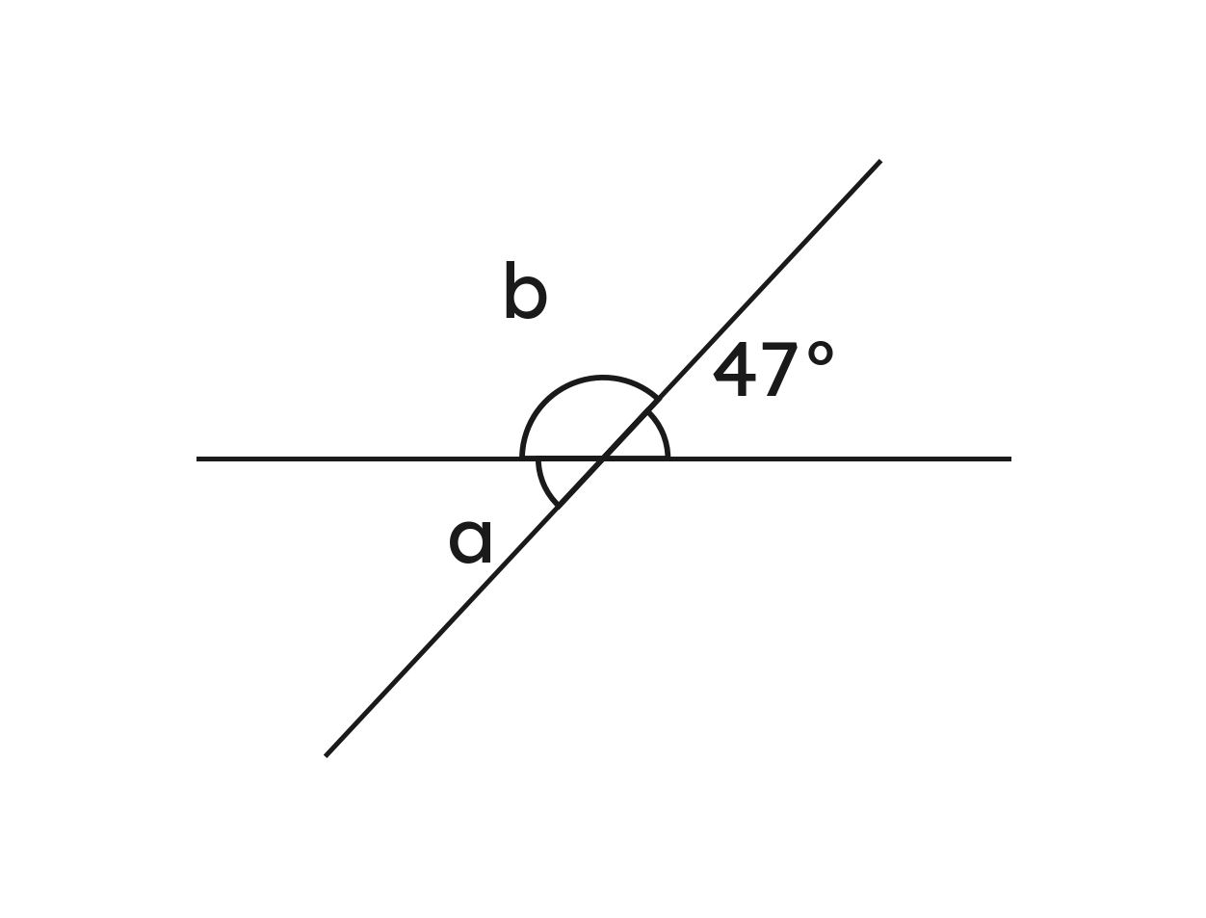
Whiteboards · Question 3 of 9
Two lines cross. One angle is 47°.
Find a and b.
Answer it.
Grade 7 Accelerated · Unit 6 · Thread B · Day 1 — Angle Pairs: Supplementary, Complementary, Vertical, Adjacent
20

Slide 21

Whiteboards · Question 3 of 9
Two lines cross. One angle is 47°.
Find a and b.
(vertical)
(a linear pair)
Answer: a = 47°, b = 133°
Grade 7 Accelerated · Unit 6 · Thread B · Day 1 — Angle Pairs: Supplementary, Complementary, Vertical, Adjacent
21

Slide 22




Whiteboards · Question 4 of 9
and
are complementary, and
.
What is
?
A. 152°
B. 62°
C. 28°
D. 118°
Answer it.
Grade 7 Accelerated · Unit 6 · Thread B · Day 1 — Angle Pairs: Supplementary, Complementary, Vertical, Adjacent
22

Slide 23




Whiteboards · Question 4 of 9
and
are complementary, and
.
What is
?
Answer: B — 62°
Grade 7 Accelerated · Unit 6 · Thread B · Day 1 — Angle Pairs: Supplementary, Complementary, Vertical, Adjacent
23

Slide 24


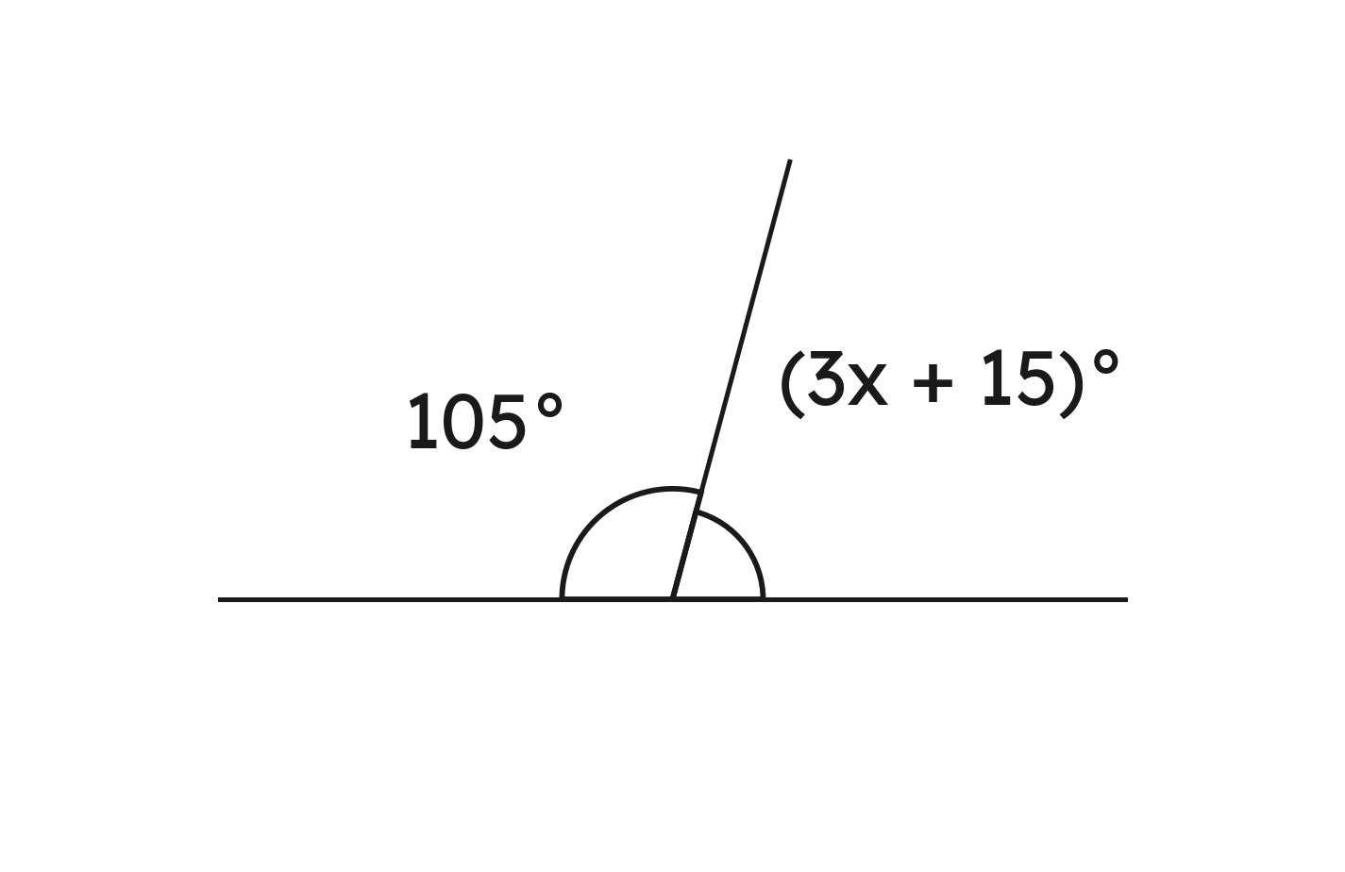
Whiteboards · Question 5 of 9
A linear pair measures
and
.
Find x.
Answer it.
Grade 7 Accelerated · Unit 6 · Thread B · Day 1 — Angle Pairs: Supplementary, Complementary, Vertical, Adjacent
24

Slide 25



Whiteboards · Question 5 of 9
A linear pair measures
and
.
Find x.
,
Answer: x = 20
Grade 7 Accelerated · Unit 6 · Thread B · Day 1 — Angle Pairs: Supplementary, Complementary, Vertical, Adjacent
25

Slide 26


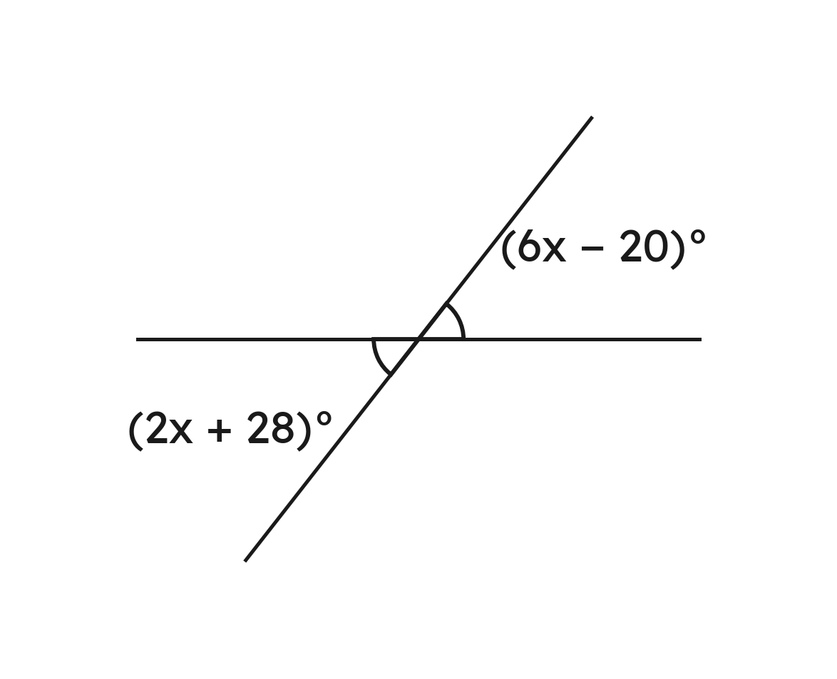
Whiteboards · Question 6 of 9
Vertical angles measure
and
.
Find the measure of each angle.
Answer it.
Grade 7 Accelerated · Unit 6 · Thread B · Day 1 — Angle Pairs: Supplementary, Complementary, Vertical, Adjacent
26

Slide 27





Whiteboards · Question 6 of 9
Vertical angles measure
and
.
Find the measure of each angle.
equal: 6x − 20 = 2x + 28, so
,
Answer: 52°
Grade 7 Accelerated · Unit 6 · Thread B · Day 1 — Angle Pairs: Supplementary, Complementary, Vertical, Adjacent
27

Slide 28
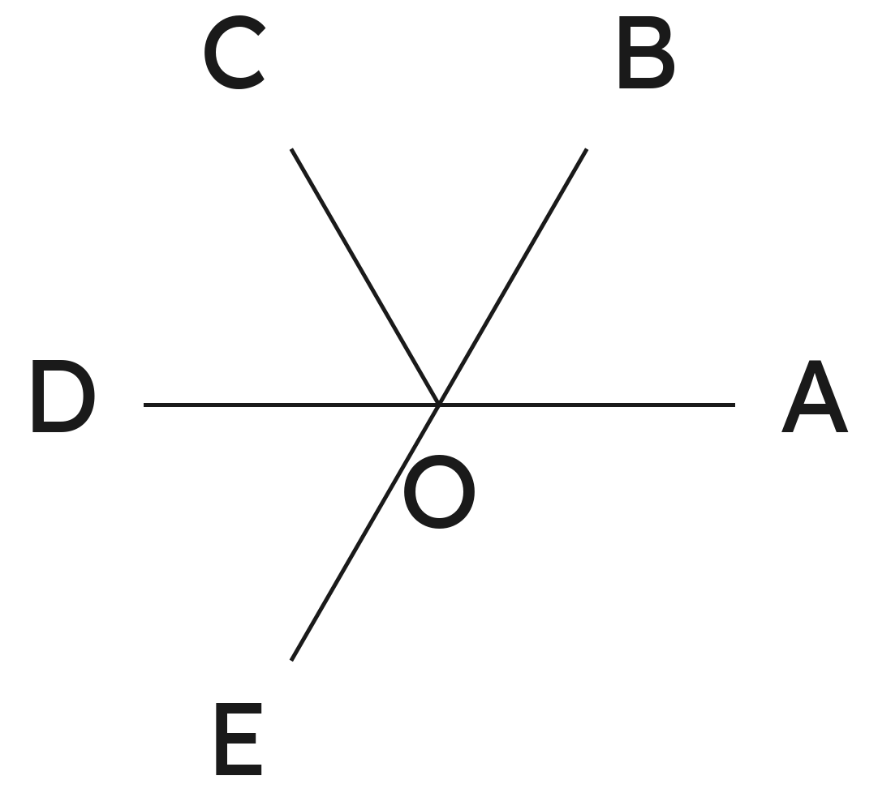
Whiteboards · Question 7 of 9
Which two angles are adjacent?
A. angles AOB and DOE
B. angles AOB and AOC
C. angles AOB and BOC
D. angles AOB and COD
Answer it.
Grade 7 Accelerated · Unit 6 · Thread B · Day 1 — Angle Pairs: Supplementary, Complementary, Vertical, Adjacent
28

Slide 29
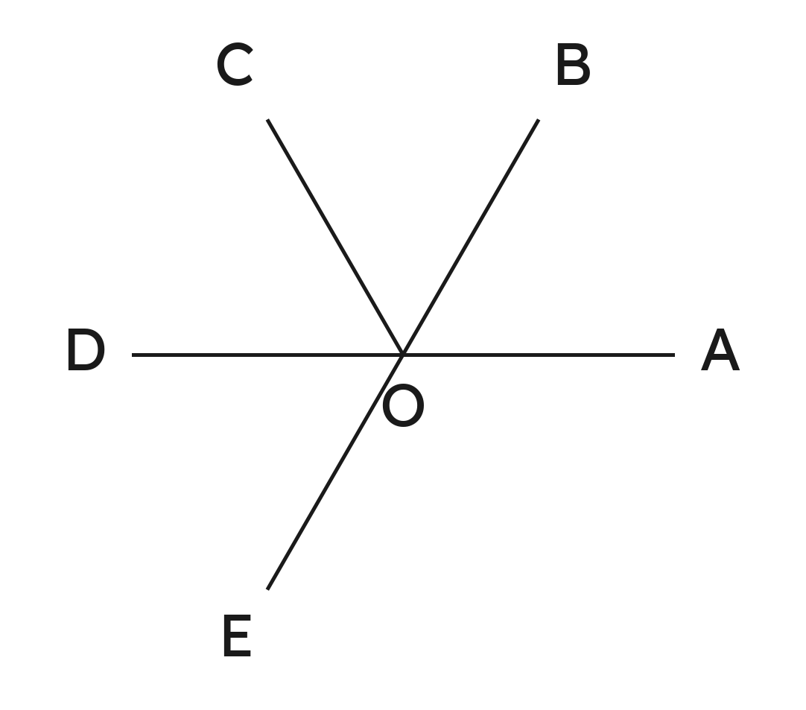
Whiteboards · Question 7 of 9
Which two angles are adjacent?
AOB and BOC share the side OB
and do not overlap
Answer: C — angles AOB and BOC
Grade 7 Accelerated · Unit 6 · Thread B · Day 1 — Angle Pairs: Supplementary, Complementary, Vertical, Adjacent
29

Slide 30
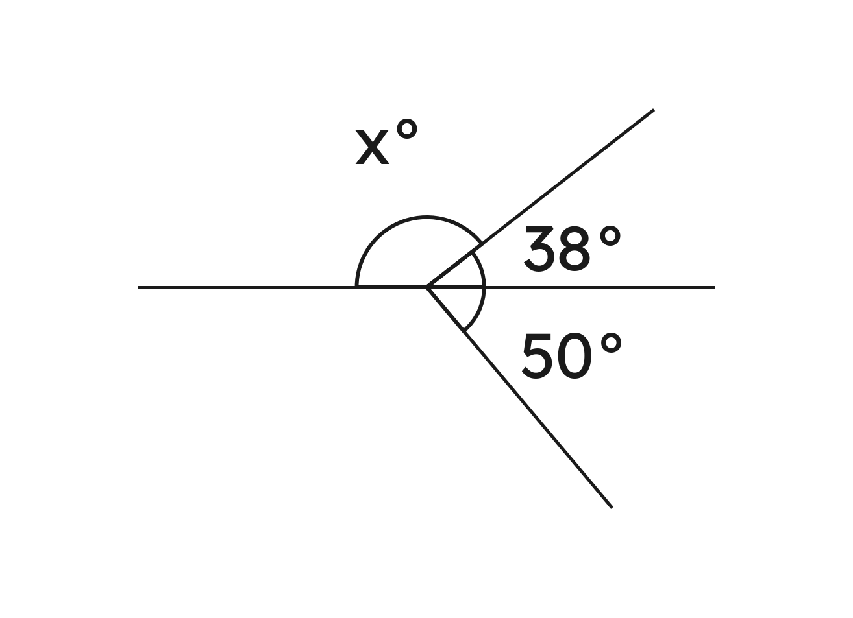
Whiteboards · Question 8 of 9
Above a straight line a ray makes angles of 38° and x°; below it another ray makes an angle of 50°.
Find x.
Answer it.
Grade 7 Accelerated · Unit 6 · Thread B · Day 1 — Angle Pairs: Supplementary, Complementary, Vertical, Adjacent
30

Slide 31


Whiteboards · Question 8 of 9
Above a straight line a ray makes angles of 38° and x°; below it another ray makes an angle of 50°.
Find x.
Answer: x = 142
Grade 7 Accelerated · Unit 6 · Thread B · Day 1 — Angle Pairs: Supplementary, Complementary, Vertical, Adjacent
31

Slide 32
Whiteboards · Question 9 of 9
Can two vertical angles be complementary?
Always, sometimes or never? Explain.
Write your answer in sentences.
Grade 7 Accelerated · Unit 6 · Thread B · Day 1 — Angle Pairs: Supplementary, Complementary, Vertical, Adjacent
32

Slide 33

Whiteboards · Question 9 of 9
Can two vertical angles be complementary?
Always, sometimes or never? Explain.
vertical: the two are equal
complementary:
each
Answer: Sometimes — only when each is 45°.
Grade 7 Accelerated · Unit 6 · Thread B · Day 1 — Angle Pairs: Supplementary, Complementary, Vertical, Adjacent
33

Slide 34








Independent Set
1.
What is the complement of 61°?
2.
What is the supplement of 76°?
3.
Two lines cross, and one of the four angles is 58°. Find the other three.
4.
A linear pair measures
and
. Find x and the first angle.
5.
Vertical angles measure
and
. Find the measure of
each angle.
6.
and
share the side QR and together make a straight line,
and
. Name the pair and find
.
Grade 7 Accelerated · Unit 6 · Thread B · Day 1 — Angle Pairs: Supplementary, Complementary, Vertical, Adjacent
34

Slide 35
IXL
1.
Open IXL and start today's skills.
2.
Work on paper where the question needs work. The answer box does not show it.
3.
Every skill listed is required, to a SmartScore of 67. Due by the Unit 11 test.
Today's skills — all required
Identify complementary, supplementary, vertical, adjacent, and congruent angles — HGV
Find measures of complementary, supplementary, vertical, and adjacent angles — R2B
Write and solve equations using angle relationships — DBV
Grade 7 Accelerated · Unit 6 · Thread B · Day 1 — Angle Pairs: Supplementary, Complementary, Vertical, Adjacent
35

